Slide 1
PLANNING AND MANAGING INFORMATION RESOURCES AND TECHNOLOGIES
Managing Information Technology
The management of information technologies played a pivotal role in assuring the success or contributing to the failure of a company's strategic business initiatives. Therefore, managing the information systems and technologies that support the modern business processes of companies today is a major challenge for both business and IT managers and professionals.

Slide 2
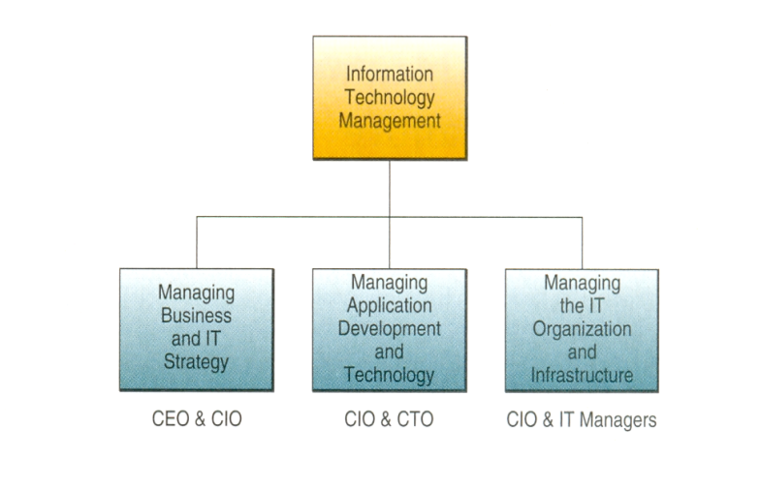
The major components of IT management

Slide 3
Managing the joint development and implementation of business/IT strategies.
Business and IT managers and professionals, led by the CEO and CIO (chief information officer), develop proposals for using IT to support the strategic business priorities of the company.
It is important to note that the focus of this business/IT planning process is to align IT with strategic goals of the business.
The process also includes evaluating the business case for investing in the development and implementation of each proposed business/IT project.

Slide 4
Managing the development and implementation of new business/IT applications and technologies.
This is the primary responsibility of the CIO and CTO (chief technology officer). This area of IT management involves
managing the processes for information systems development and implementation, as well as
the responsibility for research into the strategic business uses of new information technologies.

Slide 5
Managing the IT organization and the IT infrastructure.
IT professionals are typically organized into a variety of project teams and other organizational subunits.
The CIO and IT managers share responsibility for managing the work of these IT professionals.
In addition, they are responsible for managing the IT infrastructure of hardware, software, databases, telecommunications networks, and other IT resources, which must be
acquired, operated, monitored, and maintained.

Slide 6
Business/IT Planning
Focuses on discovering innovative approaches to satisfying a company's customer value and business value goals.
This planning process leads to development of strategies and business models for new business applications, processes, products, and services.
Then a company can develop IT strategies and an IT architecture that supports building and implementing their newly planned business applications.

Slide 7
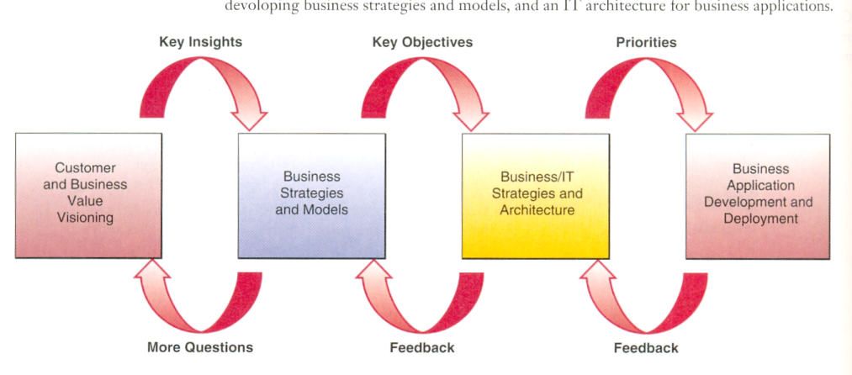
The business/IT planning process

Slide 8
Both the CEO and the chief information officer (CIO) of a company must manage the development of complementary business and IT strategies to meet its customer value and business value vision.
This co-adaptation process is necessary because as we have seen so often in this course, information technologies are a fast changing, but vital component in many strategic business initiatives.

Slide 9
The business/IT planning process has three major components
Strategy development. This is developing business strategies that support a company's business vision.
Resource management. Developing strategic plans for managing or out­sourcing a company's IT resources, including IS personnel, hardware, software, data, and network resources.
Technology architecture. Making strategic IT choices that reflect an Information Technology architecture designed to support a company's business/IT initiatives.

Slide 10
Information Technology Architecture
The IT architecture that is created by the strategic business/IT planning process is a conceptual design, or blueprint, that includes the following major components:
Technology platform.
Data resources
Applications architecture
IT Organization

Slide 11
Technology platform.
The Internet, intranets, extranets, and other networks, computer systems, system software, and integrated enterprise application software provide a computing and communications infrastructure, or platform that supports the strategic use of information technology for e-business, e-commerce, and other business/IT applications.

Slide 12
Data resources.
Many types of operational and specialized databases, including data warehouses and Internet/intranet databases store and provide data and information for business processes and decision support.

Slide 13
Applications architecture.
Business applications of information technology are designed as an integrated architecture or portfolio of enterprise systems that support strategic business initiatives, as well as cross-functional business processes.
For example, an applications’ architecture should include support for developing and maintaining the interenterprise supply chain applications, and integrated enterprise resource planning and customer relationship management applications.

Slide 14
IT organization.
The organizational structure of the IS function within a company and the distribution of IS specialists are designed to meet the changing strategies of a business.
The form of the IT organization depends on the managerial philosophy and business/IT strategies formulated during the strategic planning process.

Slide 15
Managing the IS Function
The way IT is being organized seems to be moving back to the days of mainframe and batch processing computing and this is how the author David Kirkpatrick puts it:
A Radical shift is occurring in corporate computing - think of it as the recentralization of management. It's a step back toward the 1970s, when a data-processing manager could sit at a console and track all the technology assets of the corporation. Then came the 1980s and early 1990. Departments got their own PCs and software; client/server networks sprang up all across companies.

Slide 16
Three things have happened in the past few years: The Internet boom inspired businesses to connect all those networks; companies put on their intranets essential applications without which their businesses could not function; and it became apparent that maintaining PCs on a network is very, very expensive. Such changes create an urgent need for centralization.

Slide 17
Organizing IT
The creation of information centers to support end user and workgroup computing
The development of hybrid structures with both centralized and decentralized components
For example, the IT function in some companies is organized into several business-focused development groups as well as operations management and planning groups as depicted in the figure below.

Slide 18
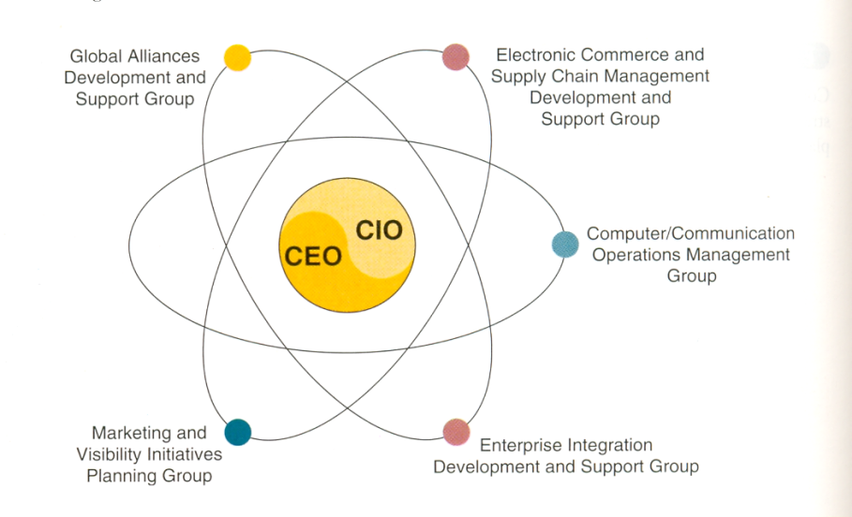

Slide 19
Some companies spin off their information systems function into IS subsidiaries
Other companies create or spin off their e-commerce and Internet-related business units or IT groups into separate companies or business units
Other corporations outsource, that is, turn over all or parts of their IS operations to outside contractors known as systems integrators.
In addition, some companies are outsourcing software procurement and support to application service providers (ASPs), who provide and support business application and other software via the Internet and intranets to all of a company's employee workstations.

Slide 20
Managing Application Development
This involves managing activities such as
systems analysis and design,
prototyping,
applications programming,
project management,
quality assurance, and
system maintenanc
for all major business/IT development projects.
Managing application development requires managing the activities of teams of systems analysts, software developers, and other IS professionals working on a variety of information systems development projects..

Slide 21
Thus, project management is a key IT management responsibility if business/IT projects are to be
completed on time,
within their budgets, as well as
meet their design objectives.
In addition, some systems development groups have established development centers staffed with IS professionals.
Their role is to evaluate new application development tools and to help information systems specialists use them to improve their application development efforts

Slide 22
Managing IS Operations
IS operations management is concerned with the use of hardware, software, network, and personnel resources in the corporate or business unit data centers (computer centers) of an organization.
Operational activities that must be managed include
computer system operations,
network management,
production control, and
production support.

Slide 23
Most operations management activities are being automated by the use of software packages for computer system performance management.
These system performance monitors
monitor the processing of computer jobs,
help develop a planned schedule of computer operations that can optimize computer system performance, and
produce detailed statistics that are invaluable for effective planning and control of computing capacity.

Slide 24
Such information evaluates
computer system utilization,
costs, and
performance.
This evaluation provides information for
capacity planning,
production planning and control, and
hardware/software acquisition planning.
It is also used in quality assurance programs, which stress quality of services to business end users

Slide 25
System performance monitors also supply information needed by chargeback systems that allocate costs to users based on the information services rendered.
All costs incurred are recorded, reported, allocated, and charged back to specific end user business units, depending on their use of system resources.
When companies use this arrangement, the information systems (services) department becomes a service center whose costs are charged directly to business units, rather than being lumped with other administrative service costs and treated as an overhead cost.

Slide 26
Many performance monitors also feature process control capabilities.
Such packages not only monitor but automatically control computer operations at large data centers.
They also enable "lights out" data centers at some companies, where computer systems are operated unattended, especially after normal business hours.

Slide 27
Human Resource Management of IT
The success or failure of an information services organization rests primarily on the quality of its people.
Many computer-using firms consider recruiting, training, and retaining qualified IS personnel as one of their greatest challenges
One of the most important jobs of information services managers is to recruit qualified personnel and to develop, organize, and direct the capabilities of existing personnel.
Employees must be continually trained to keep up with the latest developments in a fast-moving and highly technical field.
Employee job performances must be continually evaluated and outstanding performances rewarded with salary increases or promotions.

Slide 28
The CIO and Other IT Executives
The chief information officer (CIO) oversees all use of information technology in many companies, and brings them into alignment with strategic business goals.
CIOs concentrate on business/IT planning and strategy.
They also work with the CEO and other top executives to develop strategic uses of information technology in electronic business and commerce that help make the firm more competitive in the marketplace.
Many companies have also filled the CIO position with executives from the business functions or units outside the IS field. Such CIOs emphasize that the chief role of information technology is to help a company meet its strategic business objectives.

Slide 29
Technology Management
The management of rapidly changing technology is important to any organization. Changes in information technology, like the rise of the PC, client/server networks, and the Internet and intranets, have come swiftly and dramatically and are expected to continue into the future.
Developments in information systems technology have had, and will continue to have, a major impact on the operations, costs, management work environment, and competitive position of many organizations.

Slide 30
Thus, all information technologies must be managed as a technology platform for integrating internally focused or externally facing business applications.
Such technologies include the Internet, intranets, and a variety of electronic commerce and collaboration technologies, as well as integrated enterprise software for
customer relationship management,
enterprise resource planning, and
supply chain management.
In many companies, technology management is the primary responsibility of a chief technology officer (CTO) who is in charge of all IT planning and deployment.

Slide 31
Managing User Services
Teams and workgroups of business professionals commonly use PC workstations, software packages, and the Internet, intranets, and other networks to develop and apply information technology to their work activities.
Thus many companies have responded by creating user services, or client services, functions to support and manage end-user and workgroup computing.

Slide 32
End user services provide both opportunities and problems for business unit managers. For example, some firms create
an information center group staffed with user liaison specialists, or
Web-enabled intranet help desks.
IS specialists with titles such as
user consultant,
account executive, or
business analyst
may also be assigned to end user work groups.
These specialists perform a vital role by
troubleshooting problems,
gathering and communicating information,
coordinating educational efforts, and
helping business professionals with application development.

Slide 33
In addition to these measures, most organizations still establish and enforce policies for the acquisition of hardware and software by end users and business units.
This ensures their compatibility with company standards for hardware, software, and network connectivity.
Also important is the development of applications with proper security and quality controls to promote correct performance and safeguard the integrity of corporate and departmental networks and databases.

Slide 34
Failures in IT Management
Managing IT is not an easy task. The information systems function has performance problems in many organizations. The promised benefits of information technology have not occurred in many documented cases. Studies by management consulting firms and university researchers have shown that many businesses have not been successful in managing their use of information technology. Thus, it is evident that in many organizations, IT is not being used effectively and efficiently.

Slide 35
For example:
IT is not being used effectively by companies that use IT primarily to computerize traditional business processes, instead of developing innovative e-business processes involving customers, suppliers, and other business partners, electronic commerce, and Web-enabled decision support.
IT is not being used efficiently by information systems that provide poor response times and frequent downtimes, or IS professionals and consultants who do not properly manage application development projects.

Slide 36
Management Involvement and Governance
The experiences of successful organizations reveal that extensive and meaningful managerial and end user involvement is the key ingredient of high-quality information systems performance.
Involving business managers in the governance of the IS function and business professionals in the development of IS applications should thus shape the response of management to the challenge of improving the business value of information technology.

Slide 37
Involving managers in the management of IT (from the CEO to the managers of business units) requires the development of governance structures (such as executive councils and steering committees) that encourage their active participation in planning and controlling the business uses of IT.
Thus, many organizations have policies that require managers to be involved in IT decisions that affect their business units.
This helps managers avoid IS performance problems in their business units and development projects.

Slide 38
With this high degree of involvement, managers can improve the strategic business value of IT.
Also, the problems of employee resistance and poor user interface design can only be solved by direct end user participation in systems development projects.
Overseeing such involvement is another vital management task.

